Slide 2
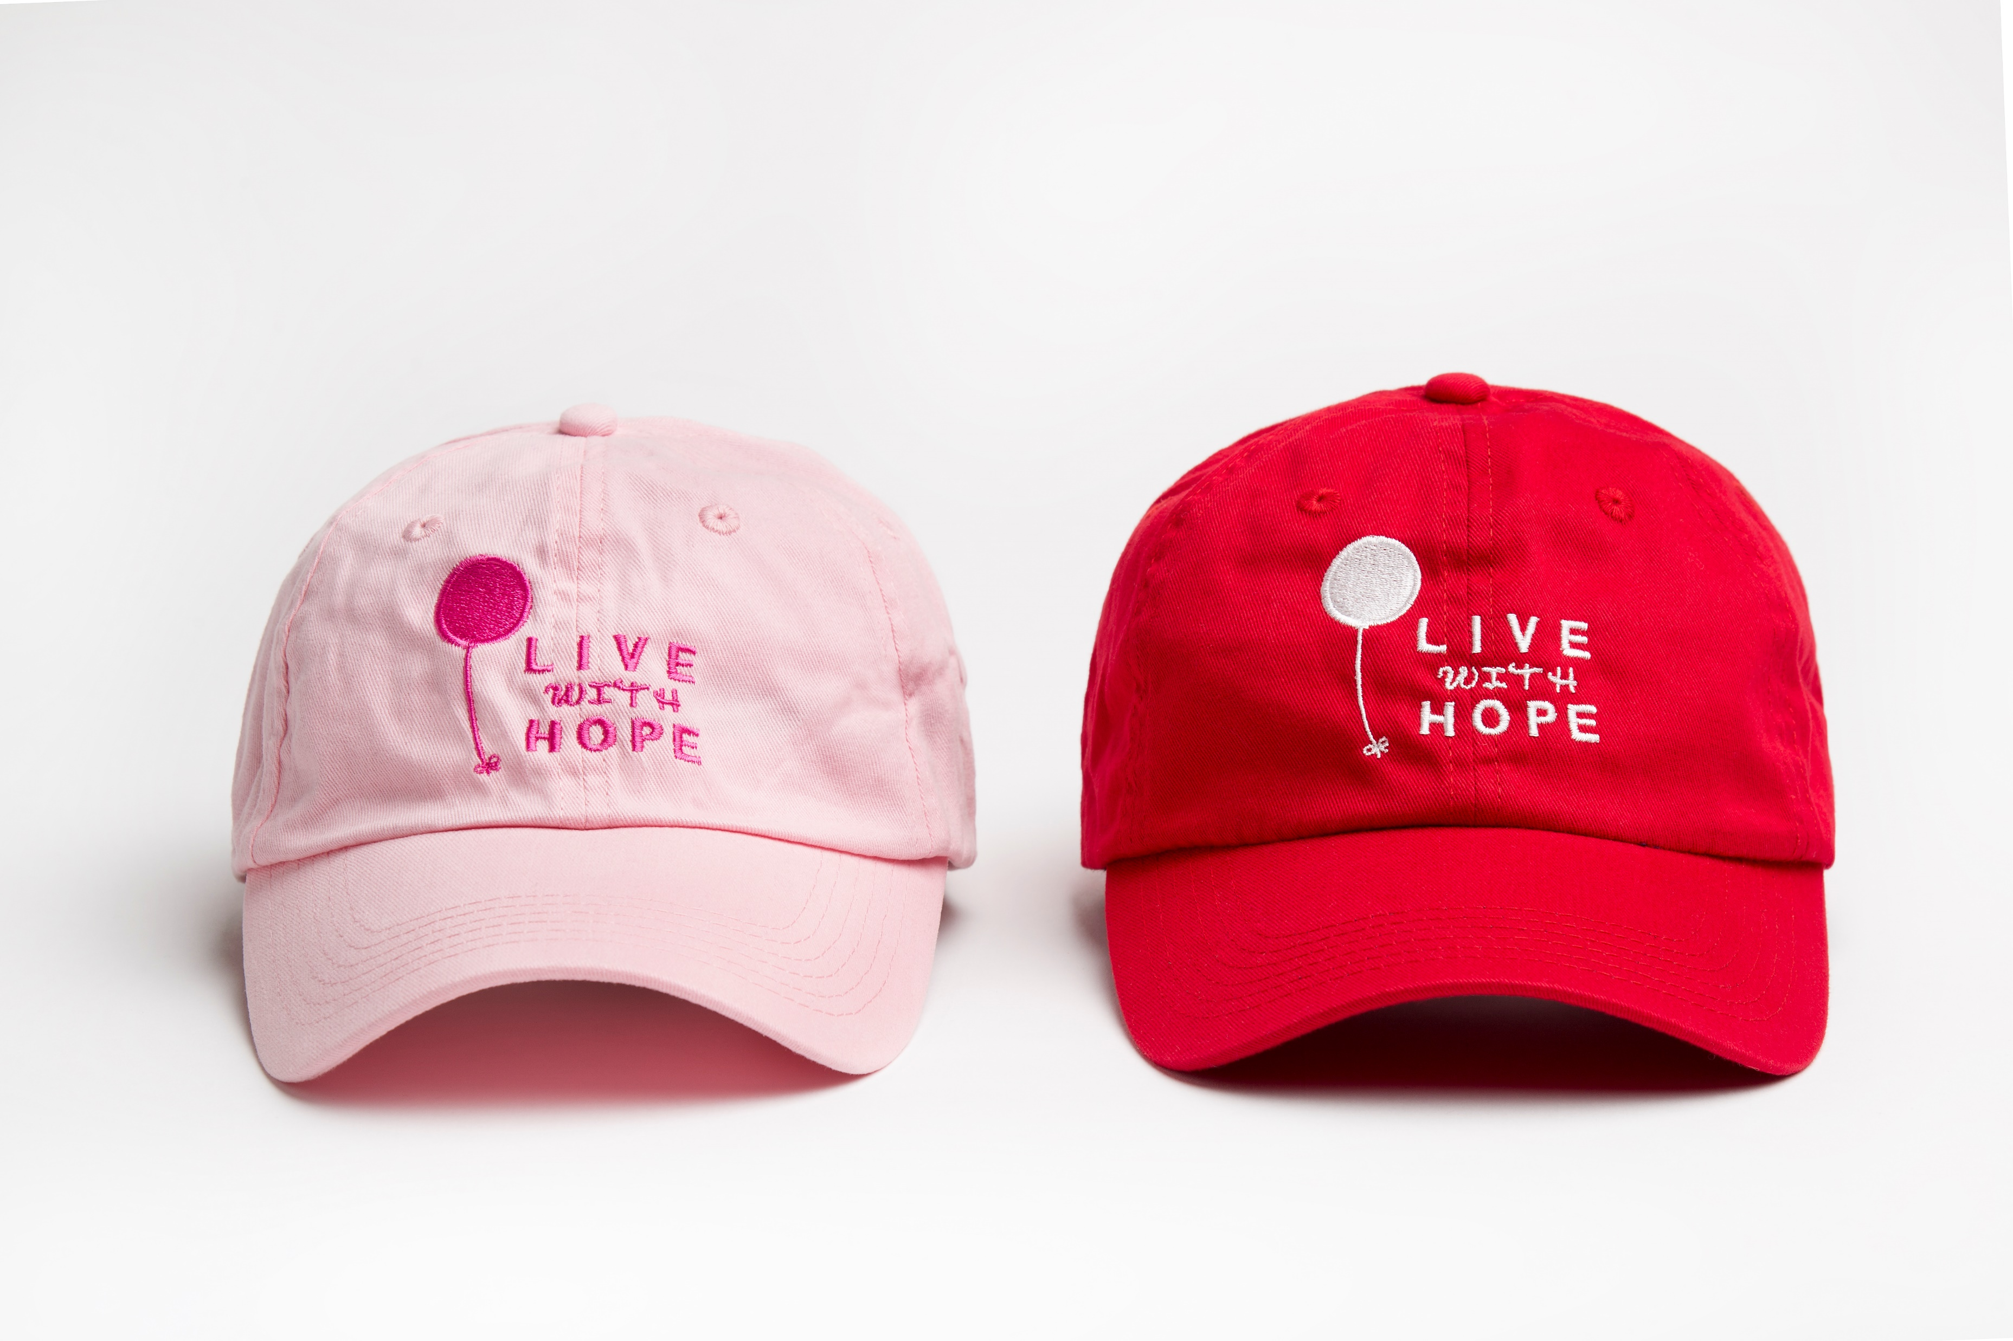
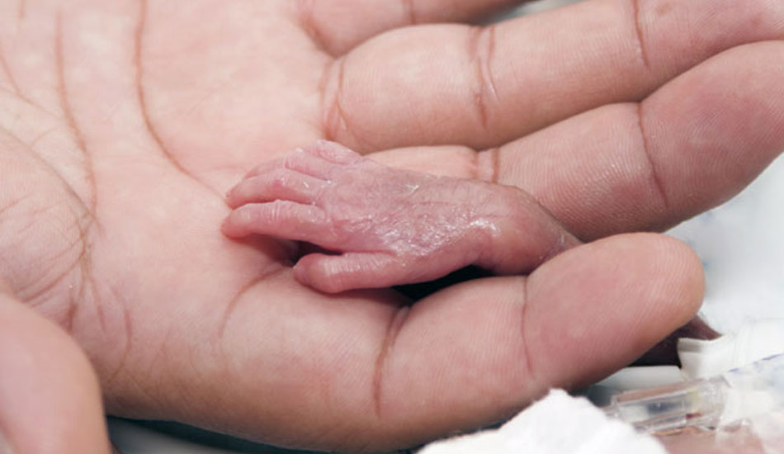
LIVE WITH HOPE
CAPS
A special reminder of the love we hold for you
and the hope we have for your future.

Slide 3
LIVE WITH HOPE
MUGS
A belief that you could make a difference led you to this path
helping others in their greatest time of need gives them Hope.

Slide 4
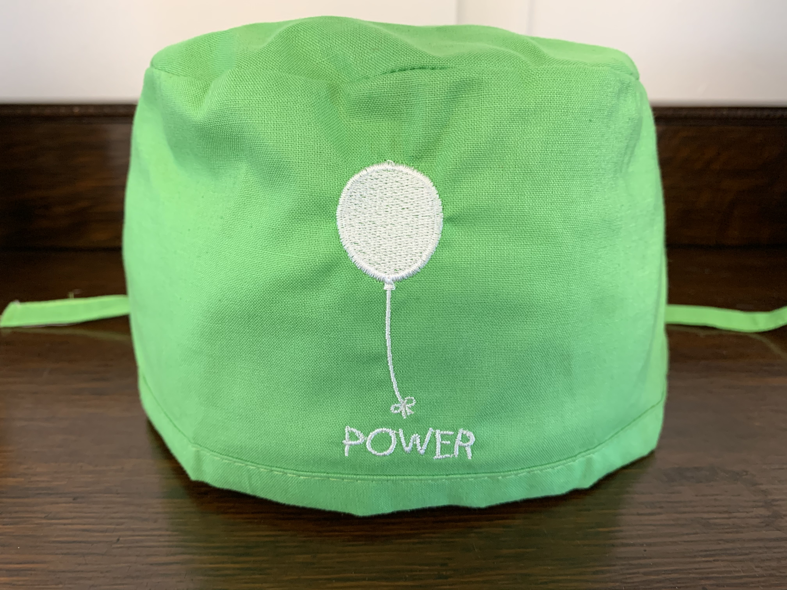
LIVE WITH HOPE
POWER CAPS
Live With Hope POWER Cap helps make your
FEEL BETTER MUSCLES work harder.

Slide 5
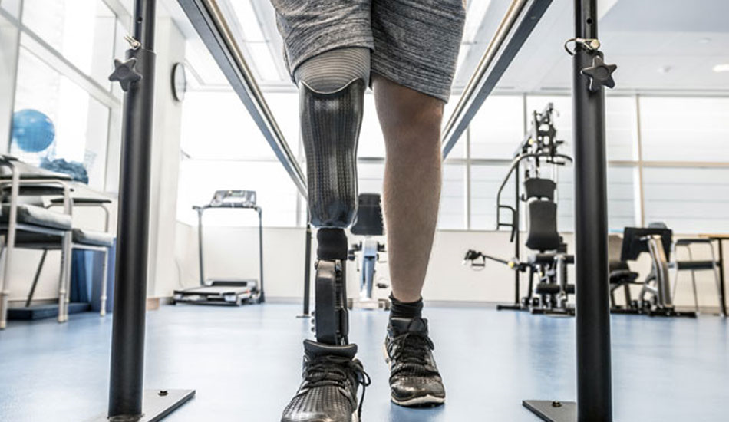
LIVE WITH HOPE
CAPS
“Hope gives us the courage to confront our circumstances
and the capacity to surmount them.”* *Groopman, Jerome. (2004). The Anatomy of Hope. New York: Random House.

Slide 6
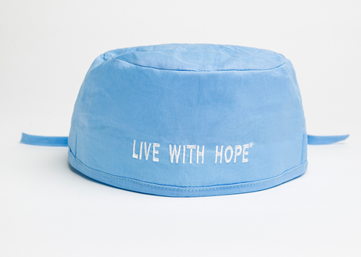
LIVE WITH HOPE
SURGICAL CAPS
A belief that you could make a difference led you to this path
helping others in their greatest time of need gives them Hope.

Slide 7
Support for Important Causes

Slide 8
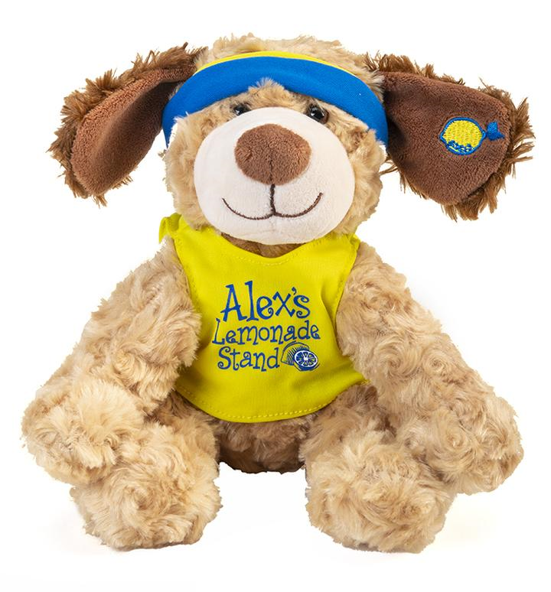
Alex’s Lemonade Stand Foundation is changing the lives of children with cancer by funding impactful research, raising awareness, supporting families and empowering everyone to help cure childhood cancer.

Slide 9
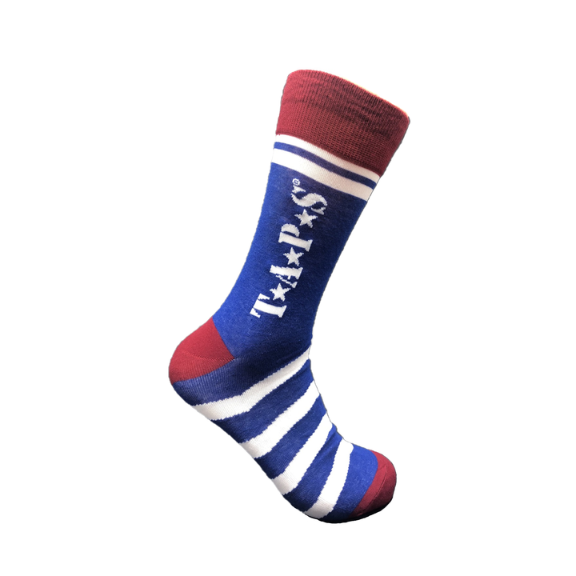
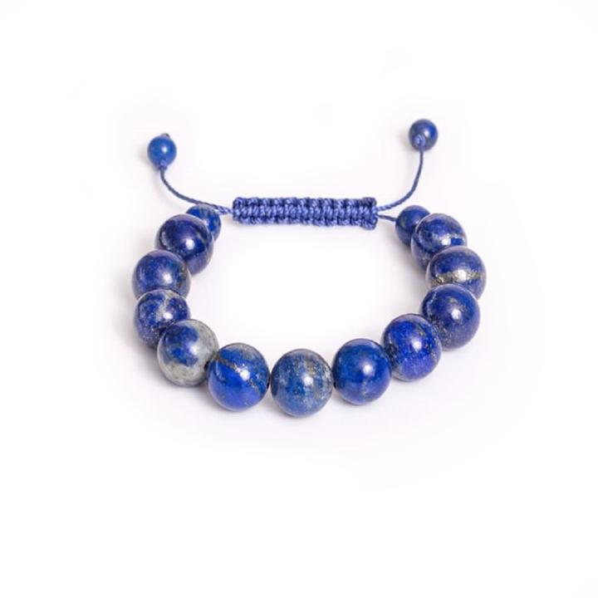
The Mission of TAPS
The Tragedy Assistance Program for Survivors (TAPS) offers compassionate care to all those grieving the loss of a loved one who died while serving in our Armed Forces or
as a result of his or her service.
TAPS has assisted more than 85,000 surviving families, casualty officers and caregivers.

Slide 10
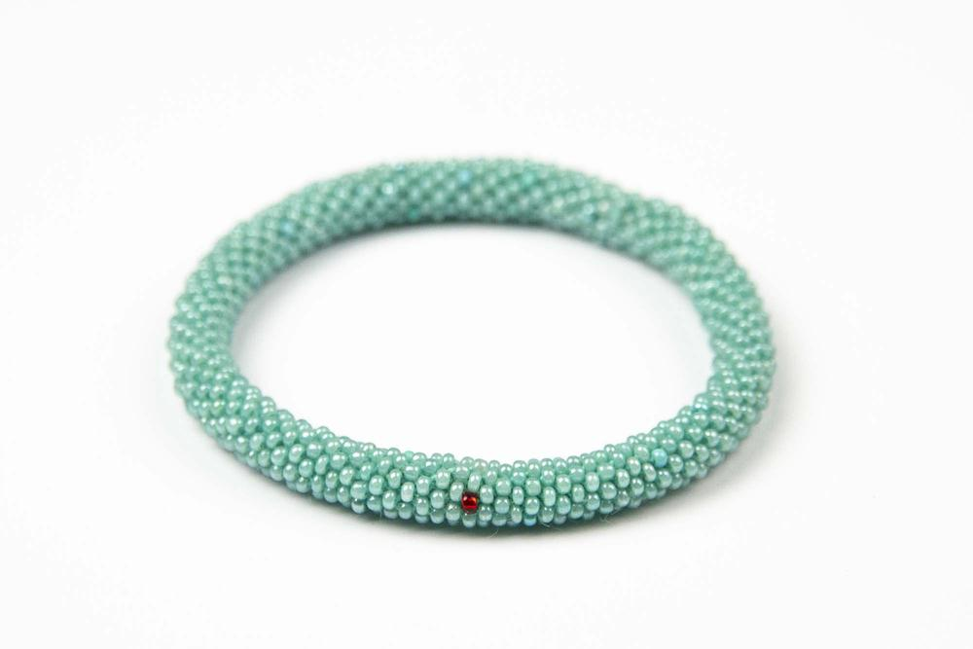
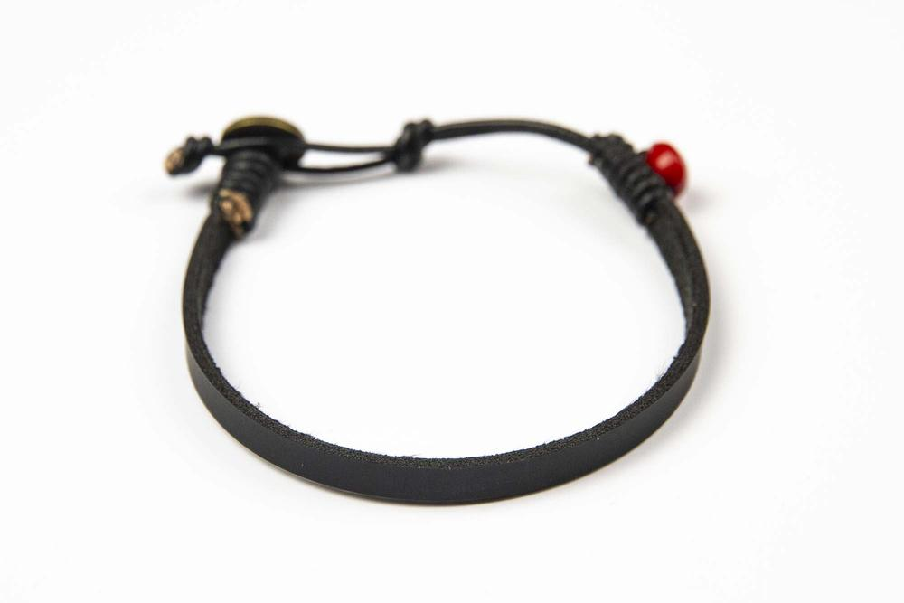
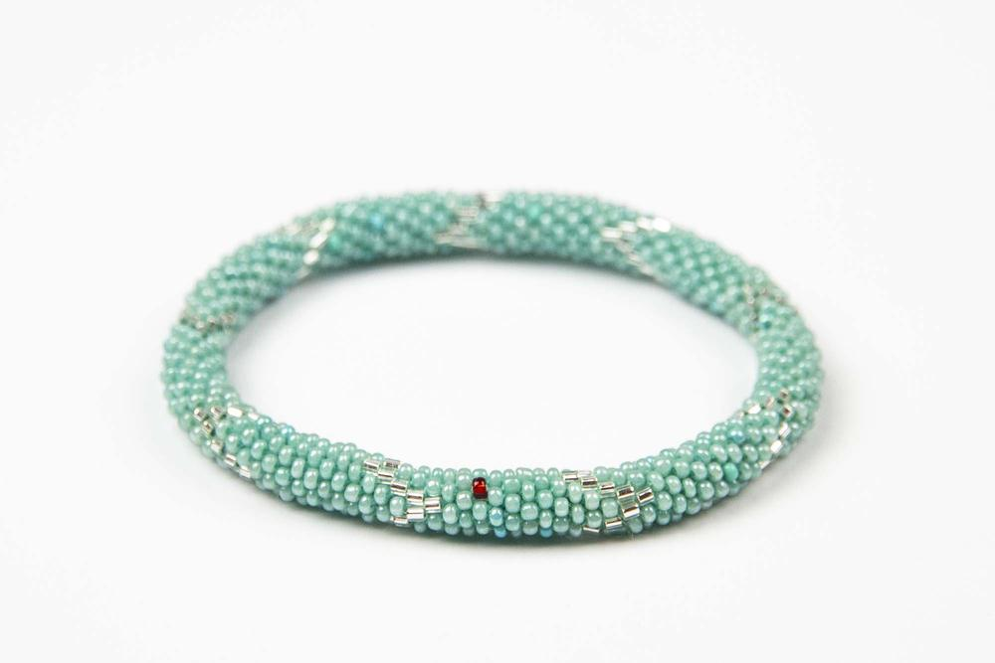
A WORLD FREE FROM HUMAN TRAFFICKING
We mobilize communities to combat human trafficking through prevention education and reintegration programs.

Slide 11
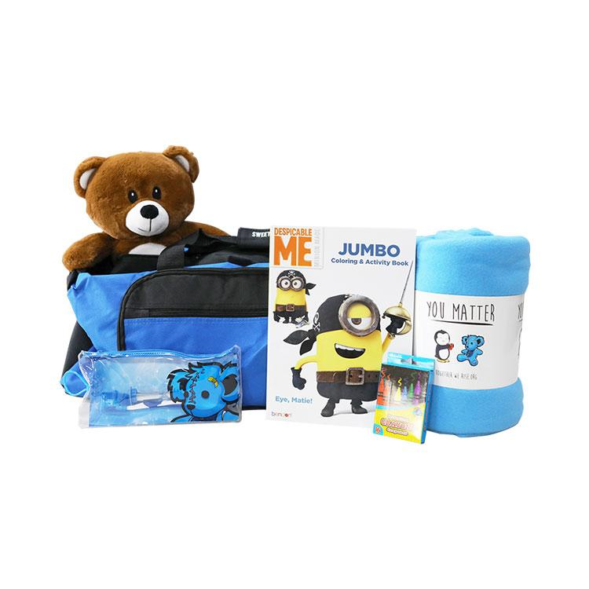
Our vision is to improve the lives of children in foster care. TWR works with hundreds of foster agencies, social workers, CASA advocates, and other partners to provide thousands of foster youth across the country with new bicycles, college supplies, and sweet cases
so that children do not have to travel from home to home with their belongings in a trash bag.
Donations are made to foster agencies
or hospital emergency departments.

